Slide 1
Retail Analytics and Insights
Sahibnoor Chahal

Slide 2





Driving Retail Success with Data
What do they buy?
Customer
Where do they shop?
How do their preferences evolve?
Who are they?

Slide 3
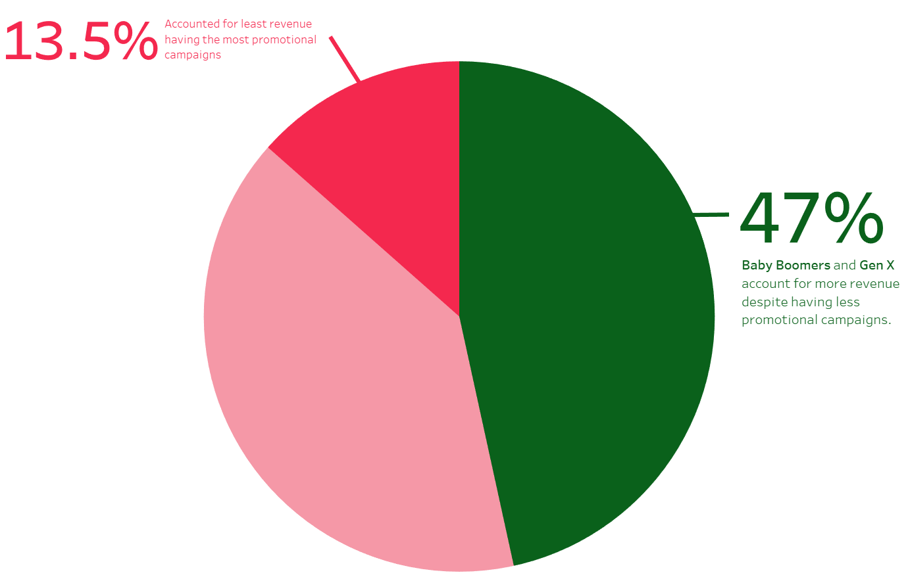
Customer Demographics

Slide 4
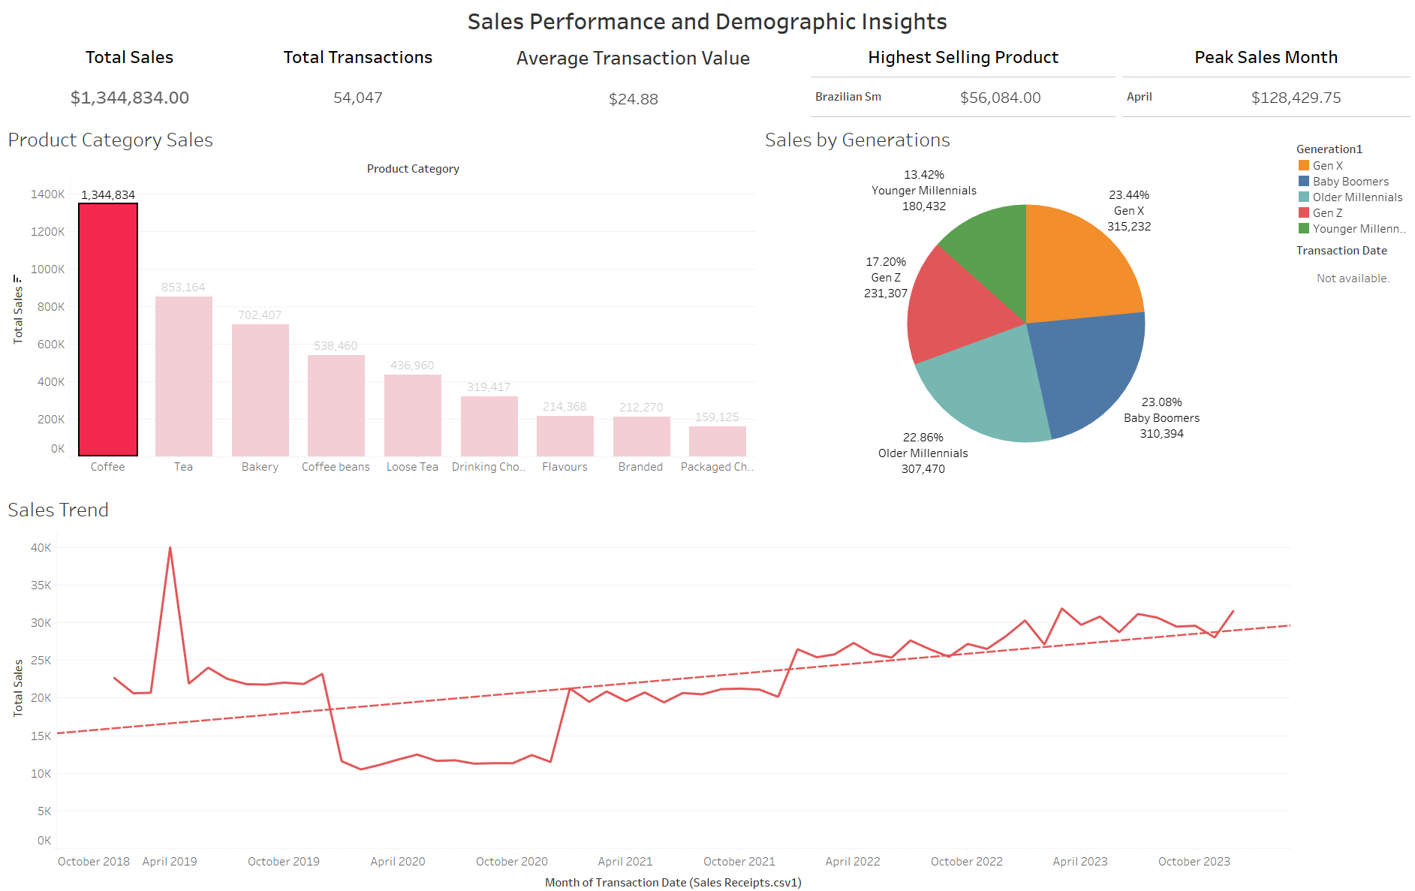
Products and Seasonal Trends

Slide 5
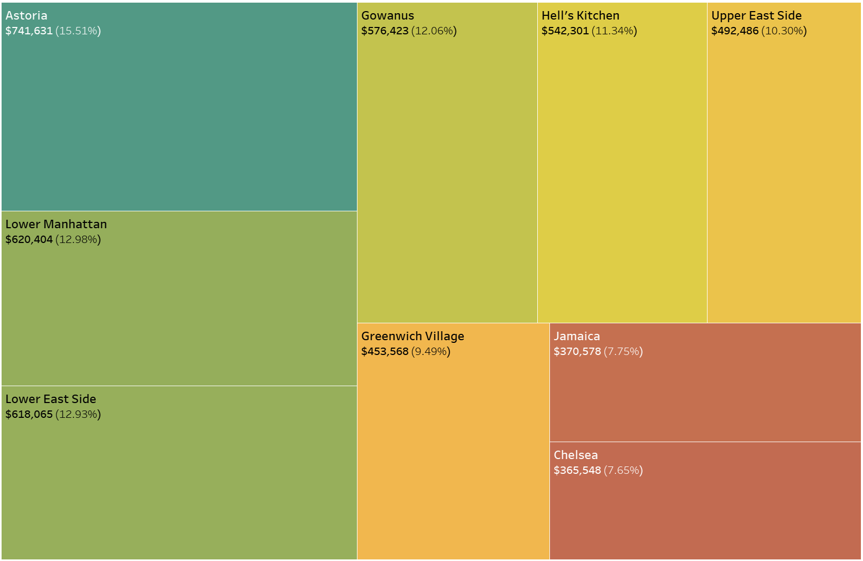
The Role of Location
Astoria leads with 15.5% of total revenue.

Slide 6
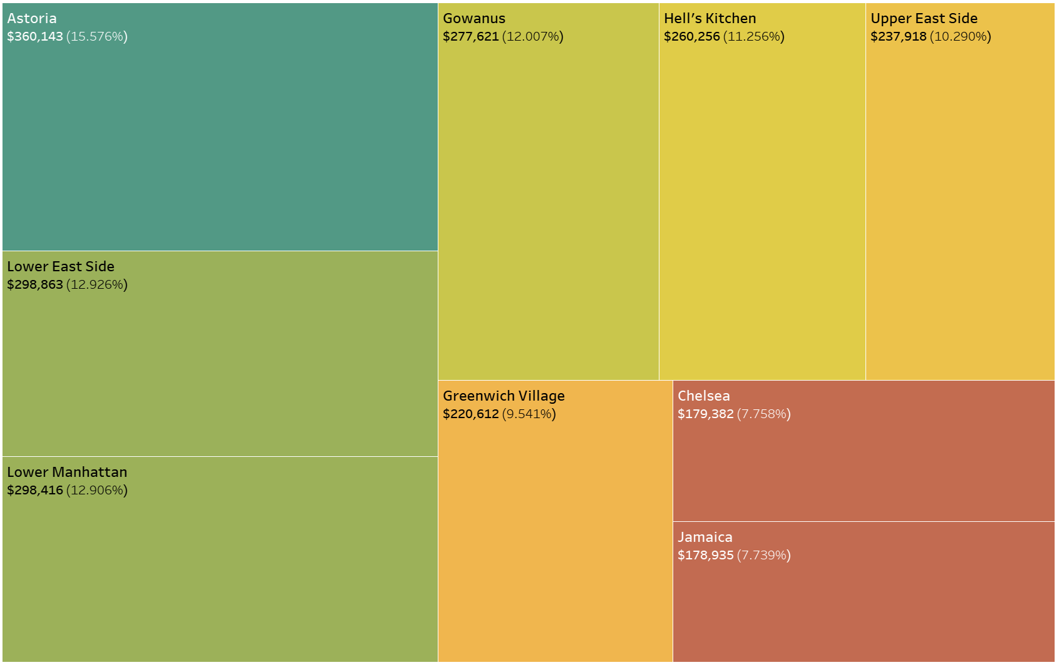
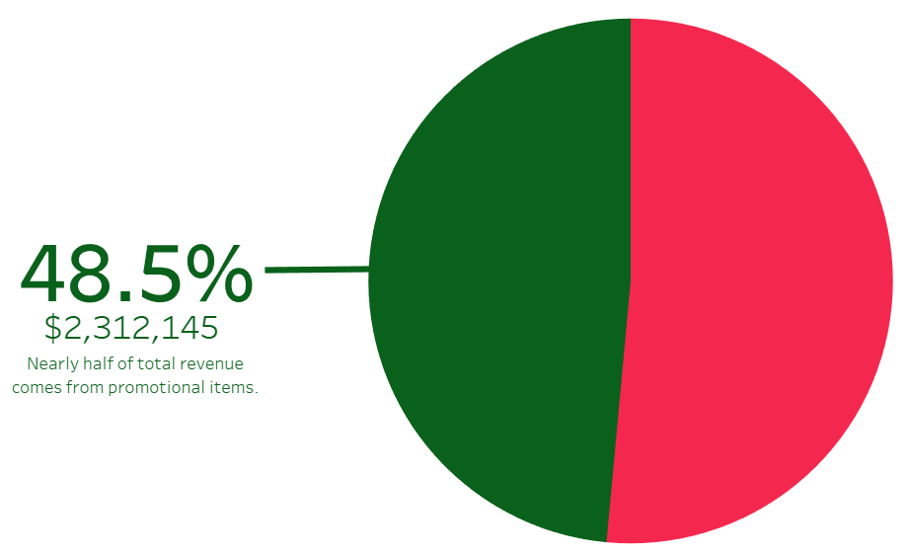
Promotional Effectiveness
Promotional
Non - Promotional

Slide 7
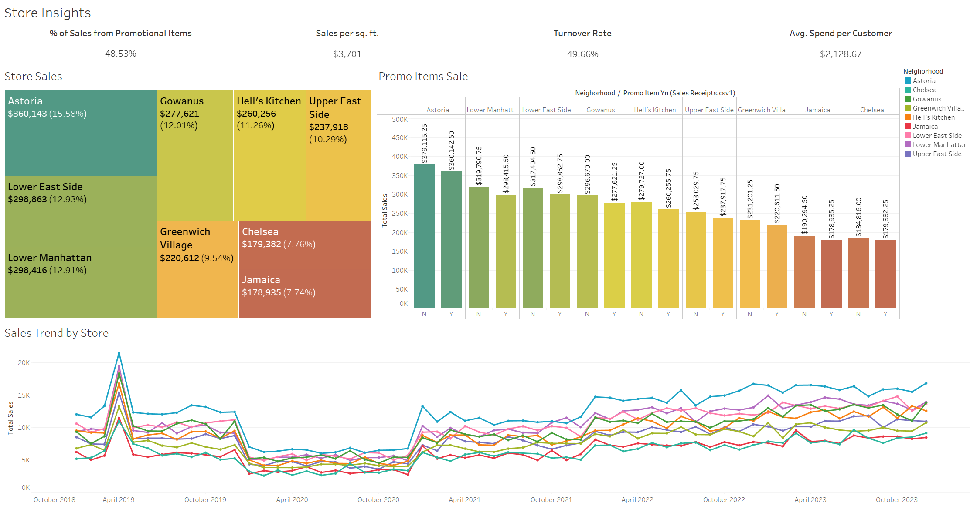
Store Insights

Slide 8
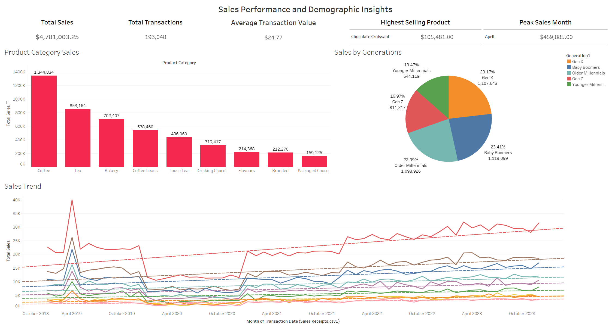
Connecting Insights to Actions

Slide 9
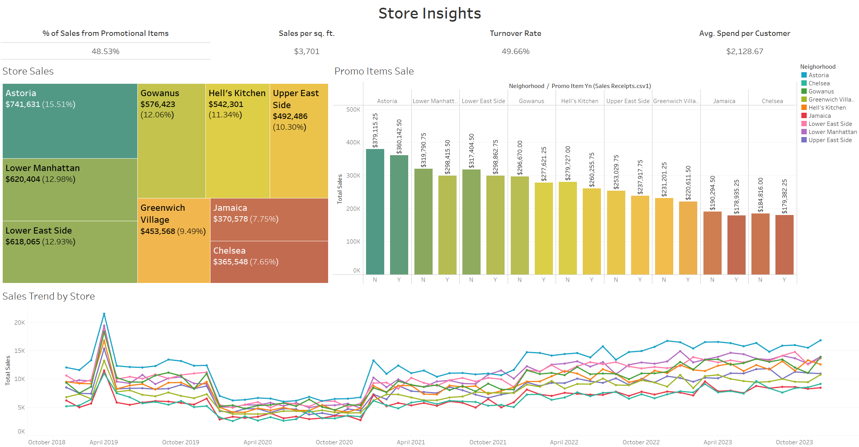

Slide 10
The Big Takeaway
This analysis tells us a clear story: Data can be a powerful tool for uncovering hidden opportunities and guiding smarter decisions.
In this case, we can make strategic decisions that drive growth an improve customer experience by understanding and acting on store-level data, promotional impacts and customer behaviors.

